Slide 1

What can 1 week of seismic data reveal about Strokkur's eruption rhythm?

Slide 2
Seismic Analysis of the Strokkur Geyser
Marwan Saad, Master Student Under Supervision of Prof. Dr. Eva Eibl Seismological Data Science with Application to Volcano Systems​

Slide 3
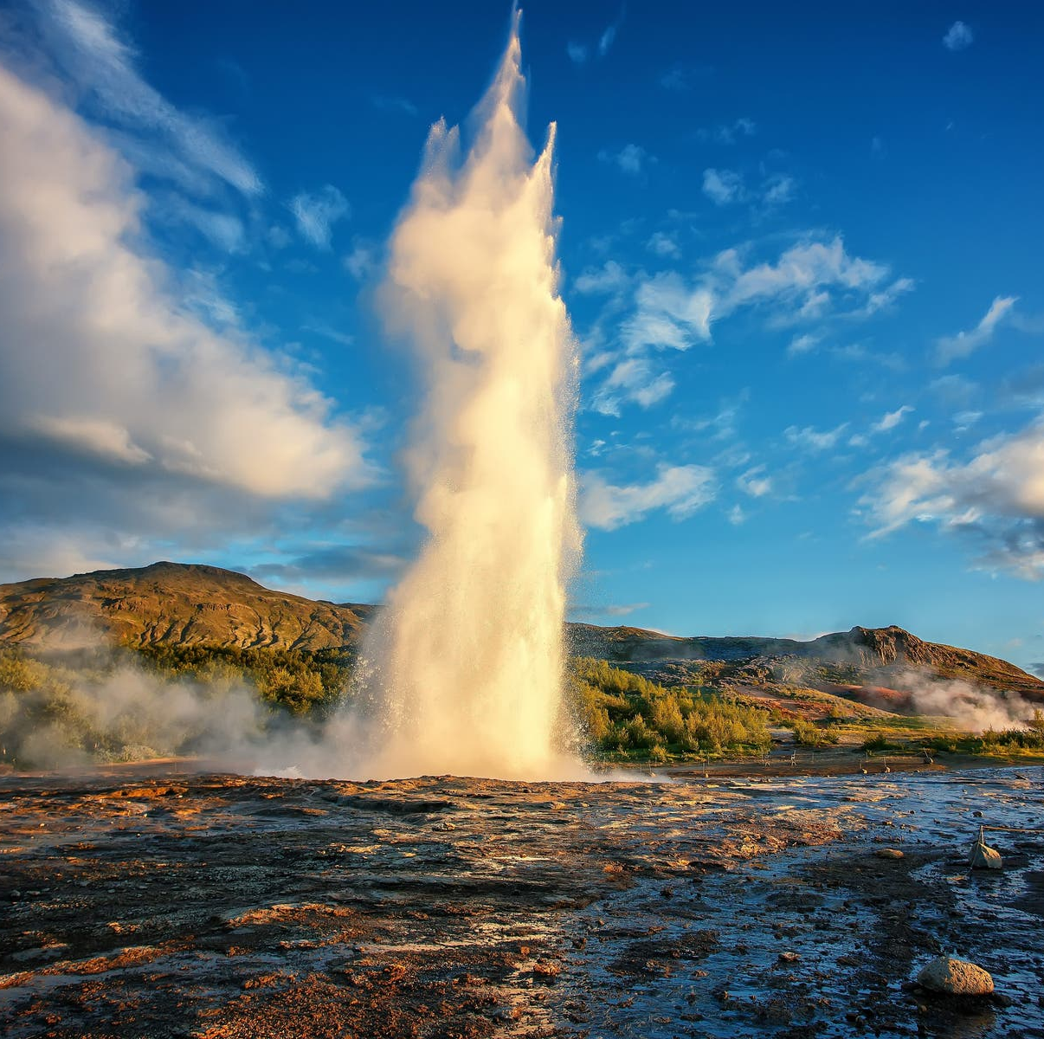
Strokkur Geyser
Location: in the Haukadalur geothermal area, southwest Iceland.
Eruption: repeatedly every few minutes, Heated groundwater, steam, and gas build pressure in the conduit.
Seismic production: Bubble collapse and rapid fluid movement generate seismic vibrations.
Seismic Monitor usefulness: enables continuous, nonvisual eruption detection and recurrence analysis.
Photo from https://guidetoiceland.is/travel-iceland/drive/strokkur

Slide 4
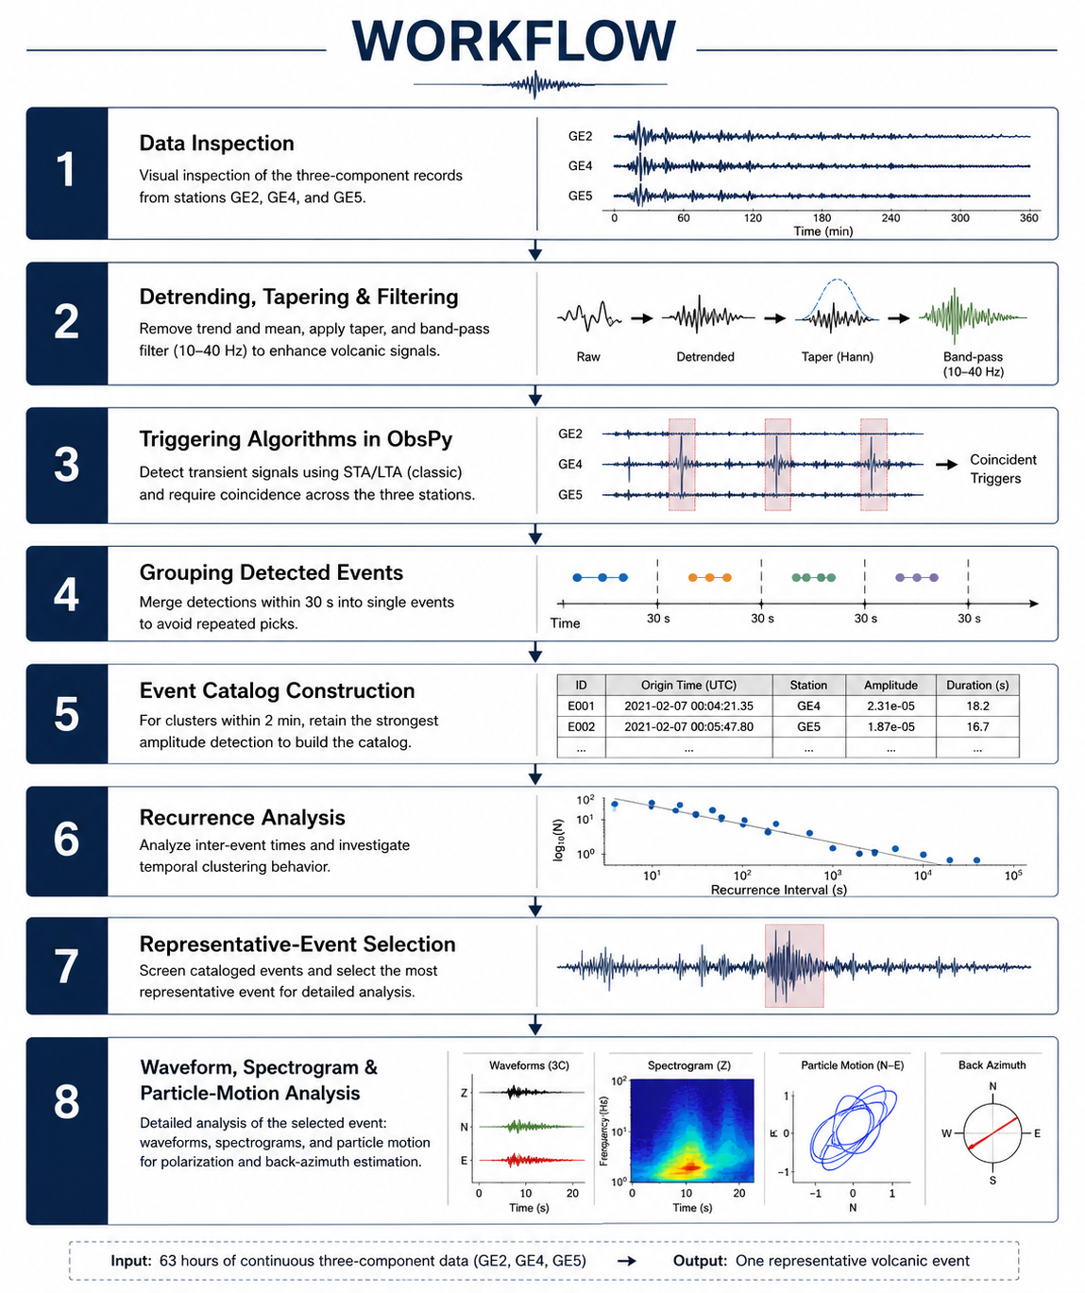
Workflow
Figure created with generative AI for illustrative purposes.

Slide 5
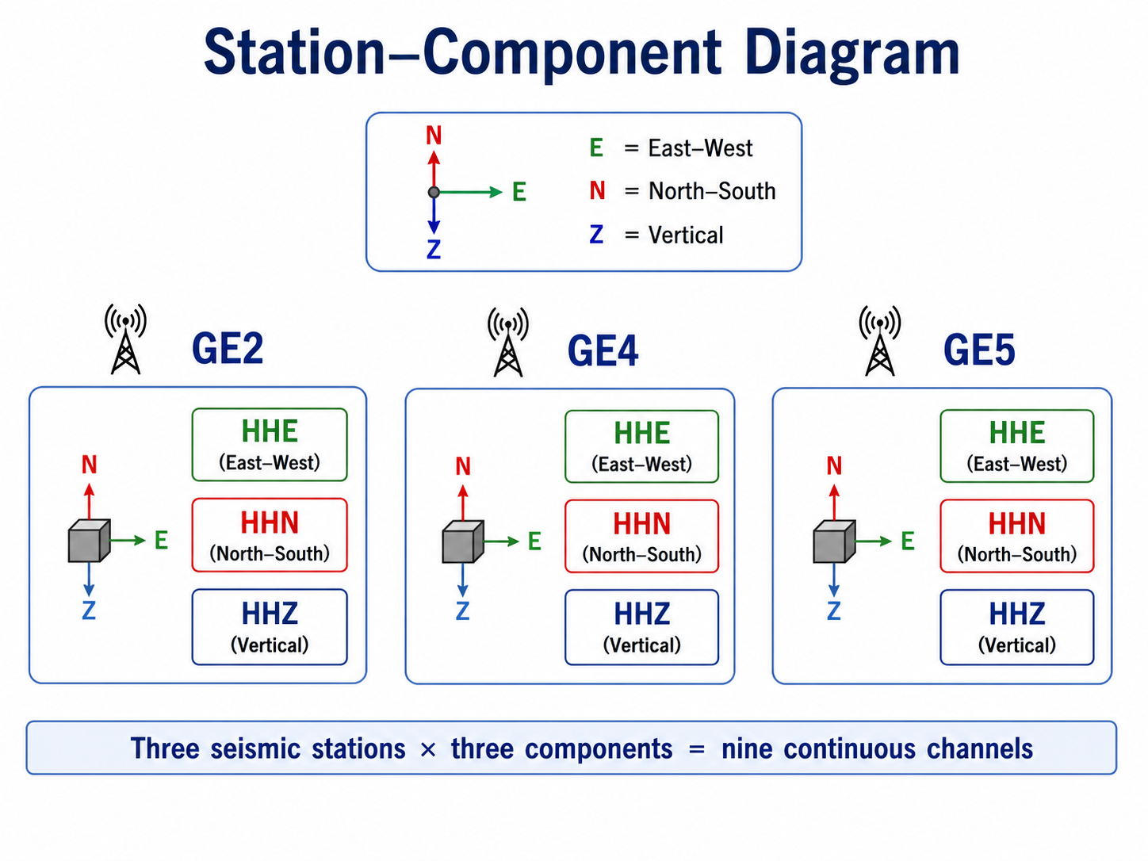
Initial Data Inspection
Sampling rate: 100 Hz.
7 days of Seismic recordings.
63 Traces.
Figure created with generative AI for illustrative purposes.

Slide 6
preprocessing
Demean
Detrend
Apply Hann Taper
Apply 10-40 Hz band-pass Filter
-Preprocessing reduced drift, edge effects, and low-frequency noise.

Slide 7
Filter Selection
Why 10-40 Hz?
Inspected waveform, spectrum, & spectrogram.
Useful event energy mainly between 10-40 Hz.
Filter preserved the transient & reduced background noise.

Slide 8
Triggering Algorithms in ObsPy
Applied to continuous data.
Detected sudden seismic transients.
Compared across 3 stations.
Retained coherent network events.

Slide 9
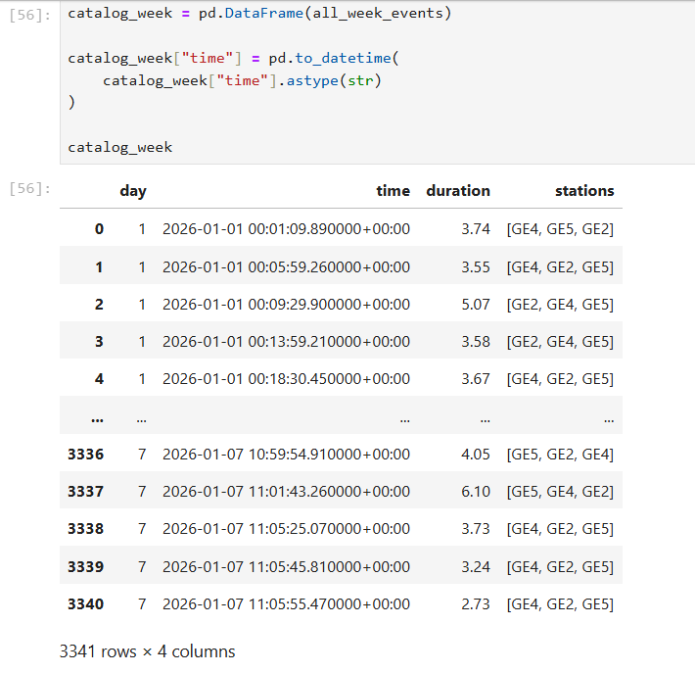
Grouping detected events
Closely spaced detections combined.
Grouping window: 30 S.
Compared across 3 stations.
Repeated triggers treated as 1 episode.
3341 transients—2904 episodes.
Screenshot from the Jupyter Notebook analysis.

Slide 10
Event cataloging
Grouped episodes within 2 m.​
Compared network peak amplitudes.​
Kept the strongest event per cluster.​
2904 episodes – 1946 principal candidates.

Slide 11
Recurrence analysis
Stable rate: 12-13 candidates/hr.​
Mean Interval: 4.78 min.​
Median interval: 4.27 min.
Most interval: 3-6 min.
-Recurrence seismic activity remained relatively regular throughout the week

Slide 12
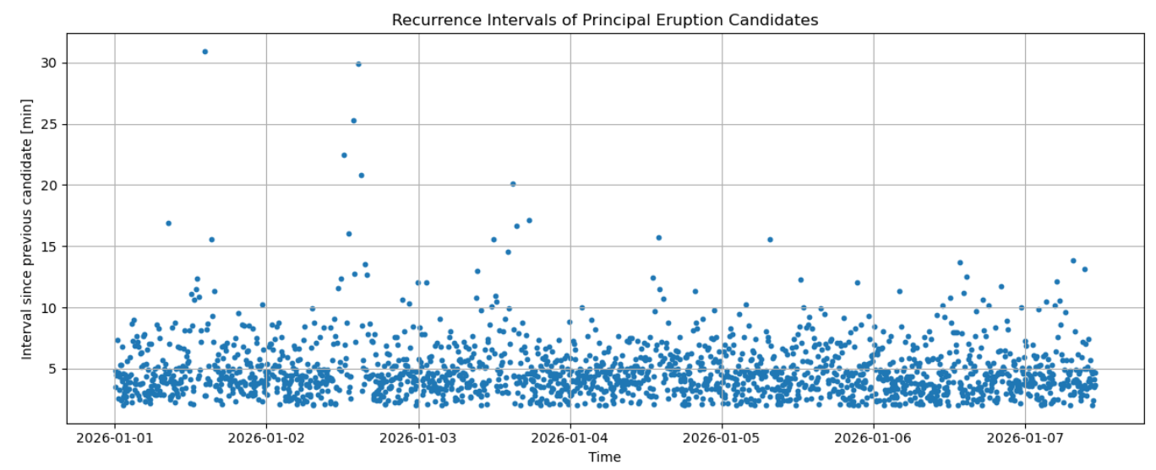
Screenshot from the Jupyter Notebook analysis.

Slide 13
Rep., event selection
Selected from final candidate catalog.
Clear at all 3 stations.​
Strong signal to noise ratio.​
Visible on HHE, HHN, HHZ.​
-Selected event: 2 January 2026 – 09:50:23.67 UTC

Slide 14
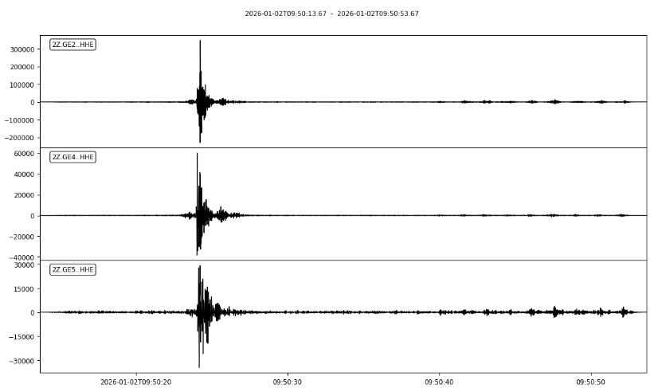
Screenshot from the Jupyter Notebook analysis.

Slide 15
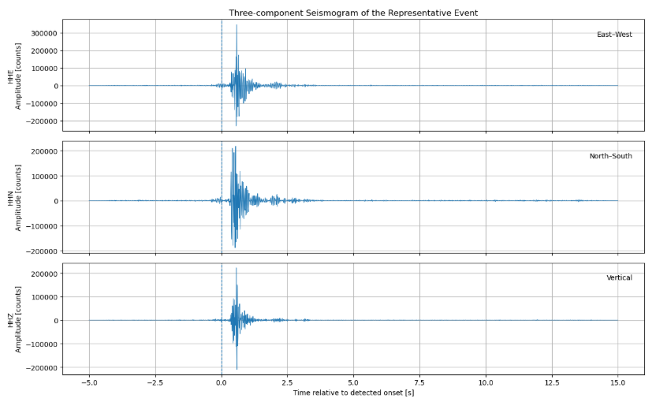
Screenshot from the Jupyter Notebook analysis.

Slide 16
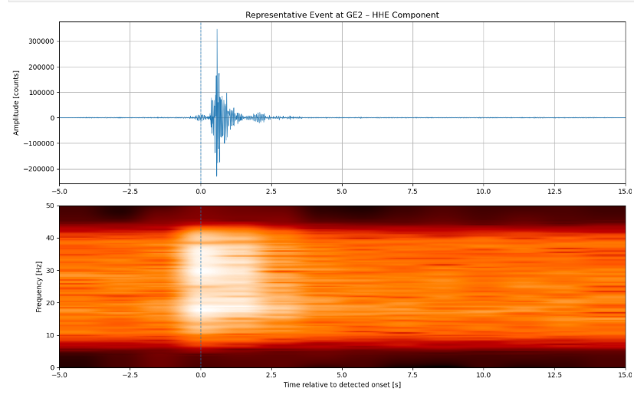
Waveform & Spectrogram
Screenshot from the Jupyter Notebook analysis.

Slide 17
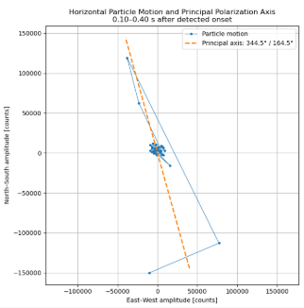
Particle motion analysis
Screenshot from the Jupyter Notebook analysis.

Slide 18
Interpretation
The data show regular, persistent seismic activity, with most candidates repeating every 3–6 minutes and the selected event showing a clear waveform, frequency signal, and directional motion.

Slide 19
Limitations
Candidates were not visually confirmed eruptions.
No station coordinates were provided.
Back azimuth retained a 180° ambiguity.
The 30 s and 2 min thresholds were project-specific choices.
Day 7 contained only about 12 hours of data.

Slide 20
Conclusions
Continuous seismic monitoring successfully detected recurring Strokkur-related events throughout the week. The principal candidates occurred mainly every 3–6 minutes, while waveform, spectrogram, and particle-motion analysis clearly characterized one representative event. The results show that seismic data can effectively monitor regular geyser activity, although independent visual confirmation and station coordinates would improve the interpretation.

Slide 21
References
Eibl, E. P. S., et al. (2020). Eruption interval monitoring at Strokkur Geyser, Iceland. Geophysical Research Letters, 47, e2019GL085266.
Eibl, E. P. S., et al. (2024). Video camera and seismic monitoring of water-bulge explosions at Strokkur Geyser, Iceland. Volcanica, 7(1).
GFZ German Research Centre for Geosciences. (2020). Seismological experiment at Strokkur from 2020—Network 2Z.
ObsPy Development Team. ObsPy documentation: Python framework for processing seismological data.

Slide 22
Thank you!
Do not be hesitant to ask any Questions!

